Slide 1



FA-25
Lecture No.03
Course: Expository Writing
Instructor: Ms. Asma Masood
10/28/2024

Slide 2





Road map of lecture
Expository Writing
Introduction to Paragraph writing
Words, Sentences, Paragraphs
Structuring effective sentences
10/28/2024

Slide 3
Paragraph Writing
A paragraph is a group of related statements that a writer develops about a subject. The first sentence states the specific point, or idea, of the topic. The rest of the sentences in the paragraph support that point.

Slide 4
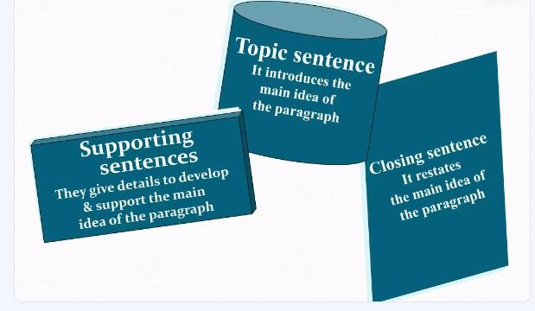
Paragraph Writing

Slide 5
Continued…
Coherence:
well organized details
clear and sensible connection linkers and connectors
Good Language: grammatical accuracy
correct punctuation, apt vocabulary variety of structure

Slide 6
Continued…
How to write a paragraph
Planning:
Selecting a topic Brainstorming ideas Determining important ideas Organizing ideas in order Making a simple outline Introduction, body, conclusion Editing and Publishing
Drafting:
Revising:

Slide 7
Example
The model paragraph that follows describes a typical wedding in Hawaii. The people who live in the island state of Hawaii are from many different ethnic groups. In Hawaii, Hawaiians, Japanese, Chinese, Filipinos, Portuguese, and haoles share their customs freely with one another. As you read the model, notice the three parts of the paragraph.

Slide 8
Continued…
A Hawaiian Wedding
The mix of cultures in Hawaii makes weddings there very special occasions. Certainly, Hawaiian clothing, music, and other Hawaiian customs play a big role. For example, the bride often wears a long white holoku (wed ding dress), and the groom wears a long-sleeved white shirt and pants with a red sash around his waist. Both the bride and the groom wear leis. The bride's lei is traditionally made of white flowers such as pikake (jasmine), and the groom's is made of green maile leaves. Another Hawaiian custom is the blowing of a conch shell three times to begin the ceremony. Hawaiian music is played both during the ceremony and during the luau afterward. Other customs included in the festivities depend on the ethnic backgrounds of the couple. AII in all, a Hawaiian wedding is truly a magical, multicultural event.

Slide 9
Continued…
Questions on the Model
1 . Look at the title. What is the topic of the paragraph?
2 . Look at the first sentence. What does it say about the topic?
3 . Now look at the last sentence. What idea from the first sentence is repeated here.

Slide 10
Continued…
Now let's study each of the three parts of a paragraph in more detail.
The topic sentence is the most important sentence in a paragraph. It has two parts: a topic and a controlling idea. The topic names the subject of the paragraph. ln our model, the topic is Hawaiian weddings. The controlling idea tells what the paragraph will say about the topic. It is called the controlling idea because it controls or limits the topic to a very specific point or points. In our model, the controlling idea is that weddings in Hawaii are special because of the mix of cultures.

Slide 11
Here are examples of topic sentences with the same topic but different controlling ideas:
----TOPIC ---, ,----- CONTROLLING IDEA --
1 a. Some marriages are a union of two families.
----TOPIC ---, CONTROLLING IDEA -
1 b. Some marriages are a union of two individuals.
----TOPIC ---, ,-CONTROLLING IDEA --
2a. Some weddings are very elaborate.
--TOPIC ---, CONTROLLING IDEA -,
2b. Some weddings are very simple.
--TOPIC ---, CONTROLLING IDEA ---
2c. Some weddings take place in unusual locations.

Slide 12
Activity
PRAC 1
With a partner, a small group, or the whole class, talk about what information the paragraph for each of the following: topic sentences might contain.
1 . Some weddings are very elaborate .
2 . Some weddings are very simple.
3 . Some weddings take place in unusual locations.
Position of the topic sentence is usually the first sentence in a paragraph. Experienced writers sometimes put topic sentences at the end, but the best place is usually right at the beginning. A topic sentence at the beginning of a paragraph gives readers an idea of what they will read. This helps them understand the paragraph more easily.
10/28/2024

Slide 13
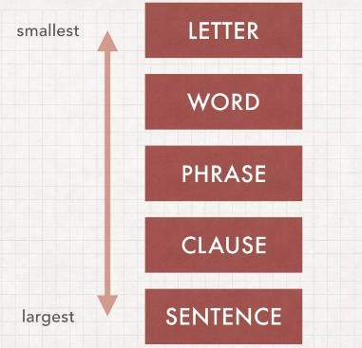
Words and Sentences
10/28/2024

Slide 14
Word and its types
Word
Definition: A word is a unit of language that has meaning and can be spoken or written. Words are made up of one or more letters and are used to form sentences.
Example: Cat, run, beautiful.
Types of Words:
Noun: A person, place, or thing (e.g., dog).
Verb: An action or state (e.g., run).
Adjective: A word that describes a noun (e.g., happy).
10/28/2024

Slide 15
Phrase and its Types
Phrase:
Definition: A phrase is a group of words that work together to convey a particular idea, but it does not form a complete sentence because it lacks a subject or a verb, or both. Phrases add detail and meaning to sentences.
Example:
  "In the morning" (prepositional phrase)
  "Very quickly" (adverbial phrase)
Types of Phrases:
Noun Phrase: "The tall tree."
Verb Phrase: "Will be going."
Adjective Phrase: "Extremely happy."
10/28/2024

Slide 16
Clause
Clause
A clause is a group of words that contains a subject and a verb. It can either stand alone as a complete sentence or be part of a larger sentence.
Types of Clauses:
1. Independent Clause
Definition: An independent clause expresses a complete thought and can stand alone as a sentence.
Example:
  "She went to the store."
  "The sun is shining."
10/28/2024

Slide 17
Continued…
Dependent (Subordinate) Clause
Definition: A dependent clause does not express a complete thought and cannot stand alone as a sentence. It depends on an independent clause to make sense.
Example:
  "Because it was raining..." (This is incomplete by itself and requires another
clause, such as "we stayed inside.")
  "Although she was tired..." (Needs a main clause to complete the sentence, such as "she finished the project.")
10/28/2024

Slide 18

Sentence Structure:
Simple Sentence Example:
  "The sun is shining." (Subject: The sun, Predicate: is shining)
Compound Sentence Example:
  "I wanted to go for a walk, but it started raining." (Conjunction: but)
Complex Sentence Example:
  "Although it was raining, we decided to go out." (Subordinating conjunction: Although)
10/28/2024

Slide 19
Run-on sentences and Fragments
Sentences with Errors:
Sentence Error (Fragment):
  Error: "Because I was late."
    (This is a fragment because it doesn't express a complete thought.)
    Correction: "Because I was late, I missed the beginning of the meeting."
  Sentence Error (Run-on):
    Error: "I love to read books I don’t have enough time to read them."
      (This is a run-on sentence because it combines two independent clauses without proper punctuation.)
      Correction: "I love to read books, but I don’t have enough time to read
them."
10/28/2024

Slide 20
Worksheet for Practice
1. When I was a child I use to play in the park every day.
2. The books on the shelf needs to be organized.
3. My friend went to the store she forgot to buy milk.
4. Running through the park, the flowers looked beautiful.
5. I can’t wait to visit Paris, it has amazing food and culture.
6. The dog chase the cat down the street.
7. I have been working all day I am tired.
8. Because she studied all night.
9. Everyone in the class were excited for the trip.
10. The cake was baking in the oven it smelled delicious.
10/28/2024

Slide 21


10/28/2024
21

